Slide 1


K. RAMAKRISHNAN COLLEGE OF ENGINEERING
(AUTONOMOUS), SAMAYAPURAM – TRICHY
DEPARTMENT OF CSE(ARTIFICIAL INTELLIGENCE AND MACHINE LEARNING)
AMC1361 – MOBILE APPLICATION DEVELOPMENT
FlyNation – International Travel Management App
PRESENTED BY
JEEVA V (8115U24AM028) SUPERVISOR
SARAN M (8115U24AM047) Mr .P.Nagaraj,M.E.,
THIRUKKUMARAN S (8115U24AM059) Assistant Professor / AI&ML.
VISHNU PRASATH R (8115U24AM063)

Slide 2

PROJECT OVERVIEW
Abstract
Introduction
Problem identification
Objectives
Research Gap
Dataset description / Working Principle
Exploratory Data Analysis
Modules identification
System Architecture / Implementation
Conclusion
References

Slide 3
ABSTRACT
FlyNation – International Travel Management App is a mobile-based application designed to simplify and manage the complete international travel process in one platform. The application helps users search and book flights and hotels, plan itineraries, manage travel documents, check visa requirements, track flight information, and receive important travel notifications.

Slide 4
INTRODUCTION
FlyNation – International Travel Management App is designed to provide a single platform for managing international travel activities. Users can search and book flights and hotels, create travel itineraries, manage passport and visa information, track flights, and receive important notifications.

Slide 5
PROBLEM IDENTIFICATION
International travelers often use multiple websites and applications for flight booking, hotel booking, visa information, itinerary planning, and travel document management. This makes the travel planning process time-consuming, confusing, and difficult to manage.

Slide 6
OBJECTIVES
The main objective of FlyNation – International Travel Management App is to provide a single, user-friendly platform for managing all major international travel activities. The application aims to simplify flight and hotel booking, visa information, travel document management, itinerary planning, flight tracking, online payments, and travel notifications.

Slide 7
RESEARCH GAP
Existing travel applications mainly focus on individual services such as flight booking, hotel booking, or destination information. However, users often need to switch between multiple platforms to manage visa requirements, travel documents, itineraries, bookings, payments, and flight updates.
.

Slide 8
DATASET DESCRIPTION / WORKING PRINCIPLE
The dataset contains information such as users, countries, destinations, flights, hotels, bookings, payments, visas, travel documents, and itineraries. User data includes basic profile and travel details, while flight and hotel datasets contain information such as destination, date, availability, price, and booking status.
.

Slide 9
EXPLORATORY DATA ANALYSIS (EDA)
  Exploratory Data Analysis (EDA) is used in the FlyNation – International Travel Management App to understand and analyze the travel-related dataset before developing the application. The dataset is examined to identify travel patterns, popular destinations, flight prices, hotel prices, booking trends, customer preferences, and seasonal demand.
.

Slide 10

MODULES IDENTIFICATION
User Management Module – Registration, login, profile, and account management.
Flight Booking Module – Search, compare, and book international flights.
Hotel Booking Module – Search hotels, check availability, and make reservations.

Slide 11
MODULES IDENTIFICATION
Visa Management Module – Check visa requirements and visa-related information.
Travel Document Module – Manage passport, visa, tickets, and other travel documents.
Payment Module – Handle online payments, transactions, and booking confirmations.

Slide 12
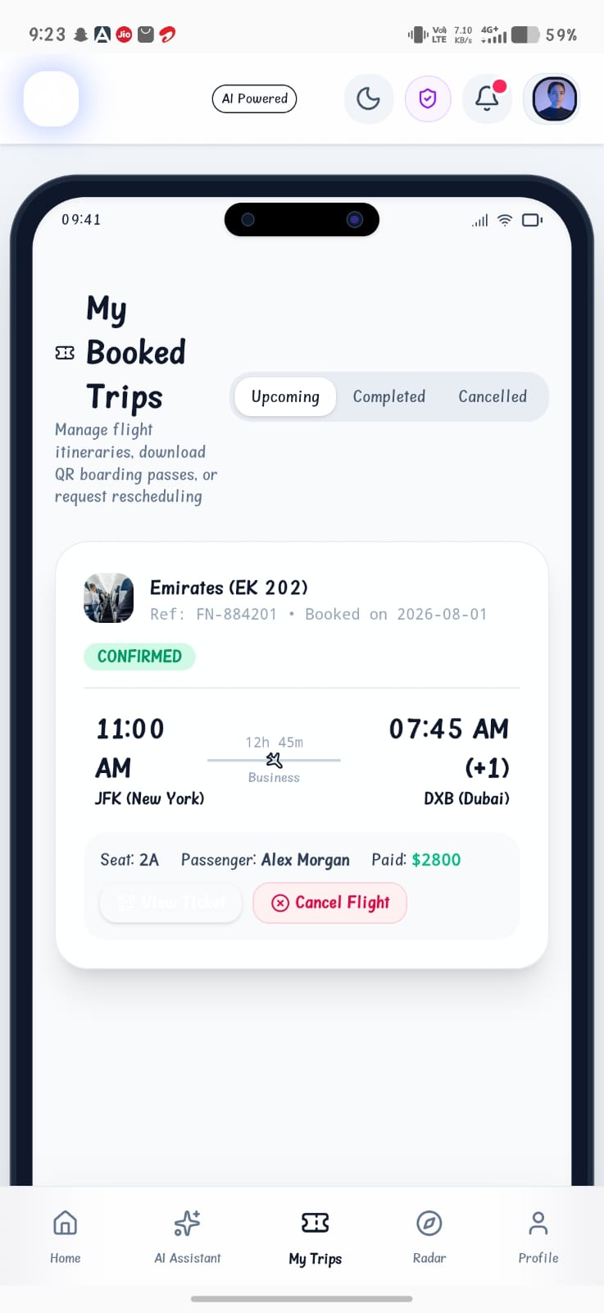
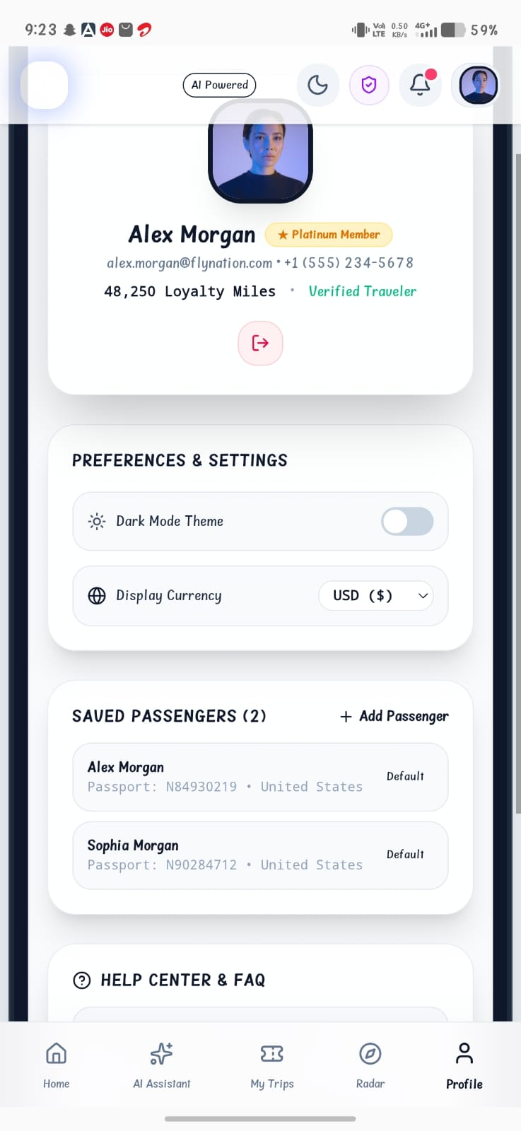
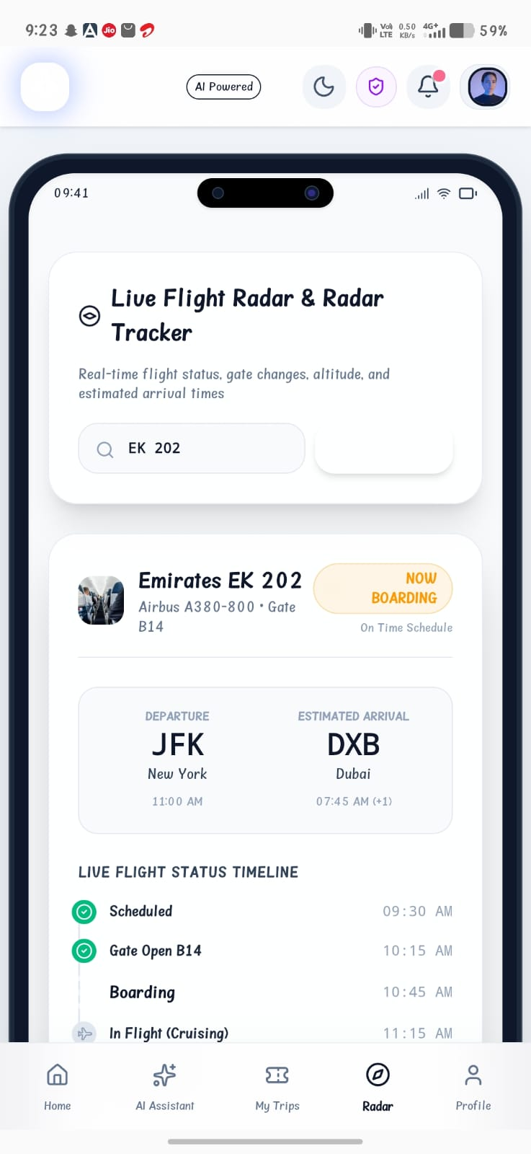
IMPLEMENTATION

Slide 13
CONCLUSION
It combines flight and hotel booking, visa information, travel document management, itinerary planning, payments, flight tracking, and notifications. The application reduces the need to use multiple travel platforms and helps users save time and effort. With its simple and user-friendly design, FlyNation makes international trip planning easy, organized, convenient, and efficient.

Slide 14
REFERENCES
International Air Transport Association (IATA)
International Civil Aviation Organization (ICAO)
World Tourism Organization (UN Tourism)
Google Maps Platform
Firebase Documentation

Slide 15


